Slide 1
Recitation 2: Full-Stack Development
February 9, 2021

Slide 2
The levels of the stack
Backend
Frontend
Deployment
Testing
Database
And more
← Today’s Focus
Notes:
These are just some of the levels of the tech stack that you will encounter when completing your projects in this class, but different rolls differ in what they consider part of a full-stack developer’s responsibilities

Slide 3
Node.js

Slide 4
What is Node?
JavaScript runtime built on the open source V8 JavaScript engine, which also powers Chrome
JavaScript that runs on server
Used to build powerful, fast, scalable web applications
Uses event-driven, non-blocking I/O model --- built to handle async Javascript via a callback system (classically)
Notes:
JavaScript runtime – The virtual machine in which JavaScript code is executed
Event driven – functions (callbacks) are executed when an event occurs
Non-blocking I/O Model – When no connections are coming into node, it sleeps. Very few of node’s operations perform disk or network I/O, so very few node operations block

Slide 5
Non-blocking I/O
Single threaded
Asynchronous function calls
Concurrency (in Node) refers to the Event Loop’s capacity to execute Javascript “callback” functions after completing other work
Dangers of mixing blocking and non-blocking code

Slide 6
Async Options?
Callbacks: functions passed to another functions ~ CALLBACK HELL!
Promises (and promise chains): structured callbacks
Generators: functions which can be exited/paused and later re-entered
Async/Await: combining generators and promises ~ async code ”made” imperative
Notes:
Promises – Synchronous objects returned from asynchronous code, that can be acted on once they’re fulfilled

Slide 7
NPM
Node Package Manager
The largest ecosystem of open-source libraries in the world
Notes:
Npm will be used for installing packages and bootstrapping node projects. It’s analogous to PyPi for python, Ruby Gems for ruby,

Slide 8
MVC and MVVM

Slide 9
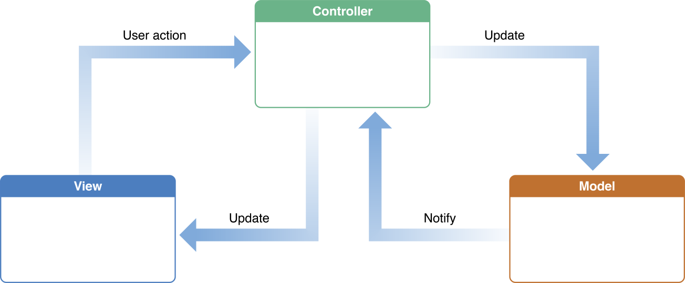
MVC

Slide 10

MVVM
Notes:
Model-View-ViewModel (MVVM) is a structural design pattern that separates objects into three distinct groups:
- Models hold application data. They’re usually structs or simple classes.
- Views display visual elements and controls on the screen. They’re typically subclasses of UIView.
- View models transform model information into values that can be displayed on a view. They’re usually classes, so they can be passed around as references.

Slide 11
A coding example
A simple To-Do app

